Slide 1
Switch Case Practice

Slide 2
Rules of Using Switch Case in C Programming
Case Label must be unique
Case Labels must ends with Colon
Case labels must have constants / constant expression
Case label must be of integral Type ( Integer,Character)
Case label should not be ‘floating point number ‘
Switch case should have at most one default label
Default label is Optional
Default can be placed anywhere in the switch
Break Statement takes control out of the switch
Two or more cases may share one break statement
Nesting ( switch within switch ) is allowed.
Relational Operators are not allowed in Switch Statement.
Macro Identifier are allowed as Switch Case Label.
Const Variable is allowed in switch Case Statement.
Empty Switch case is allowed.

Slide 3
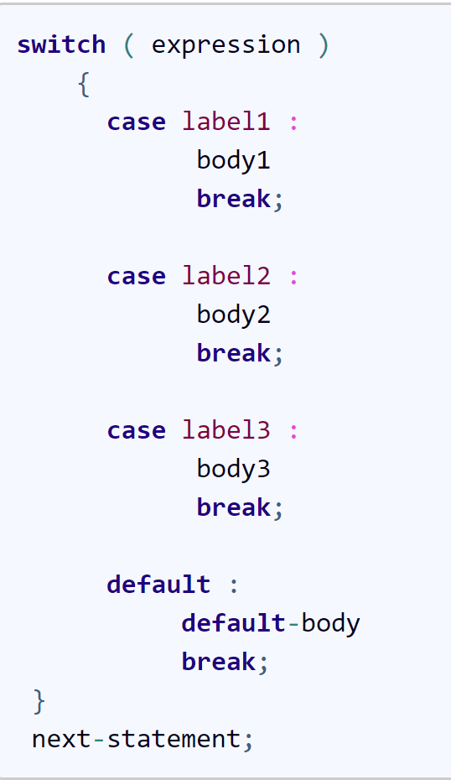
Syntax of Switch Case :

Slide 4
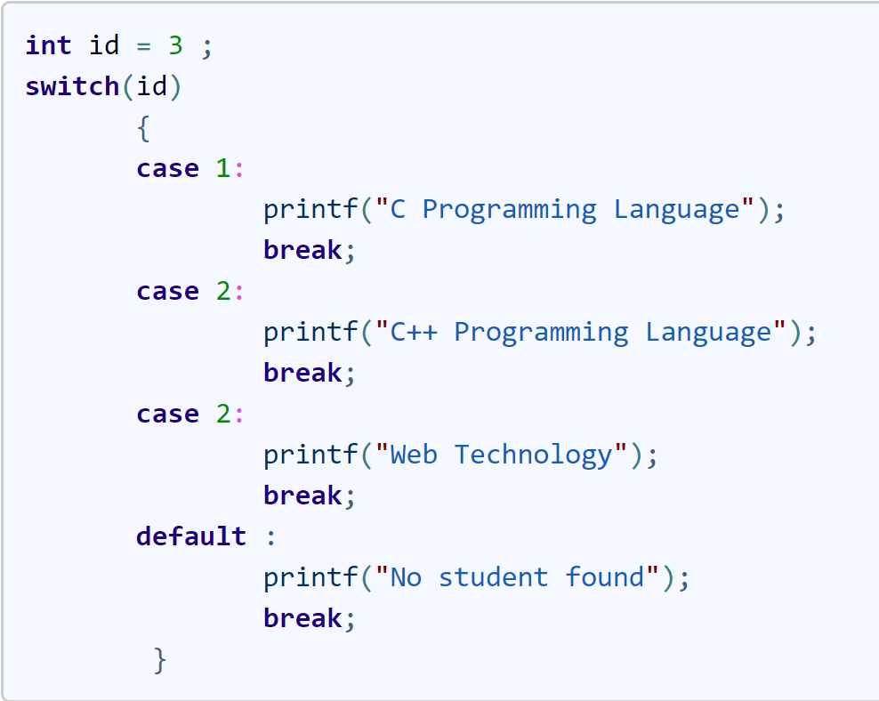
Rule 1 : Case Label must be unique

Slide 5
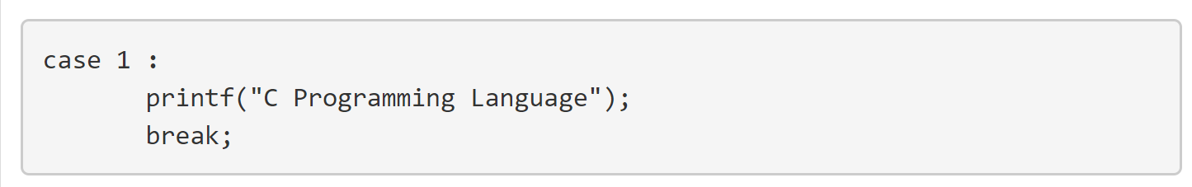
Rule 2 : Case Labels must ends with Colon

Slide 6
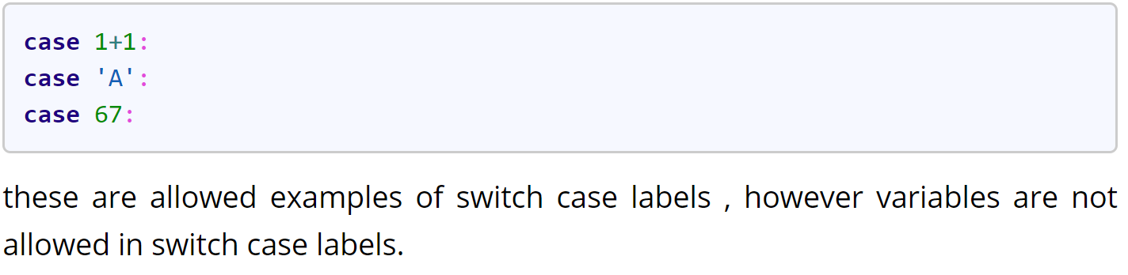
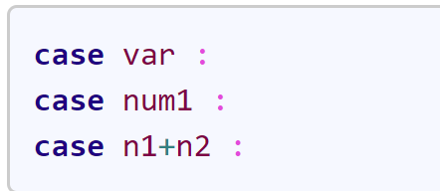
Rule 3 : Case labels must have constants / constant expression

Slide 7
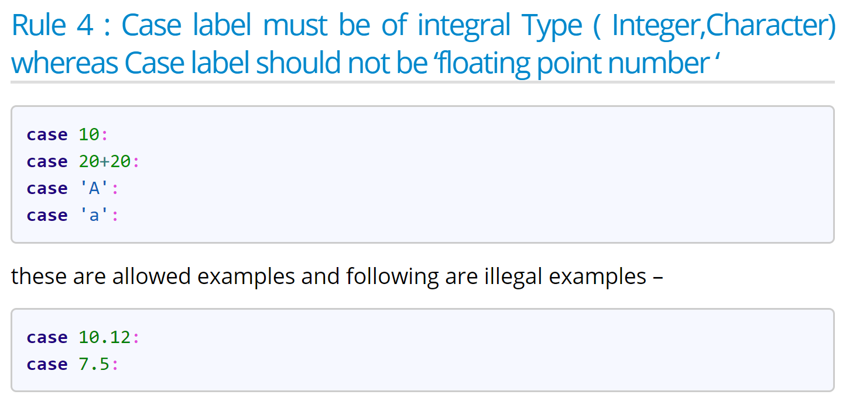

Slide 8
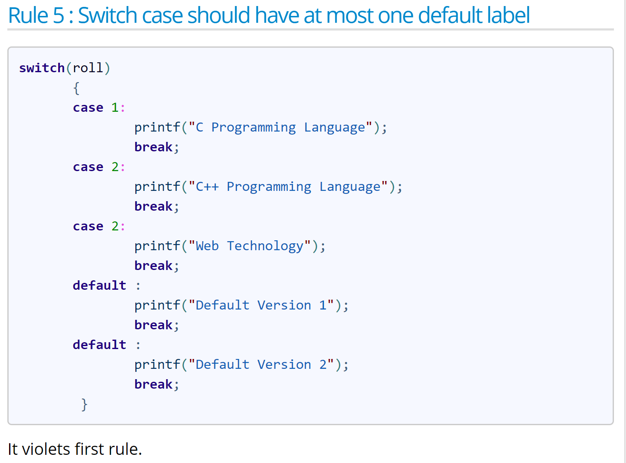

Slide 9
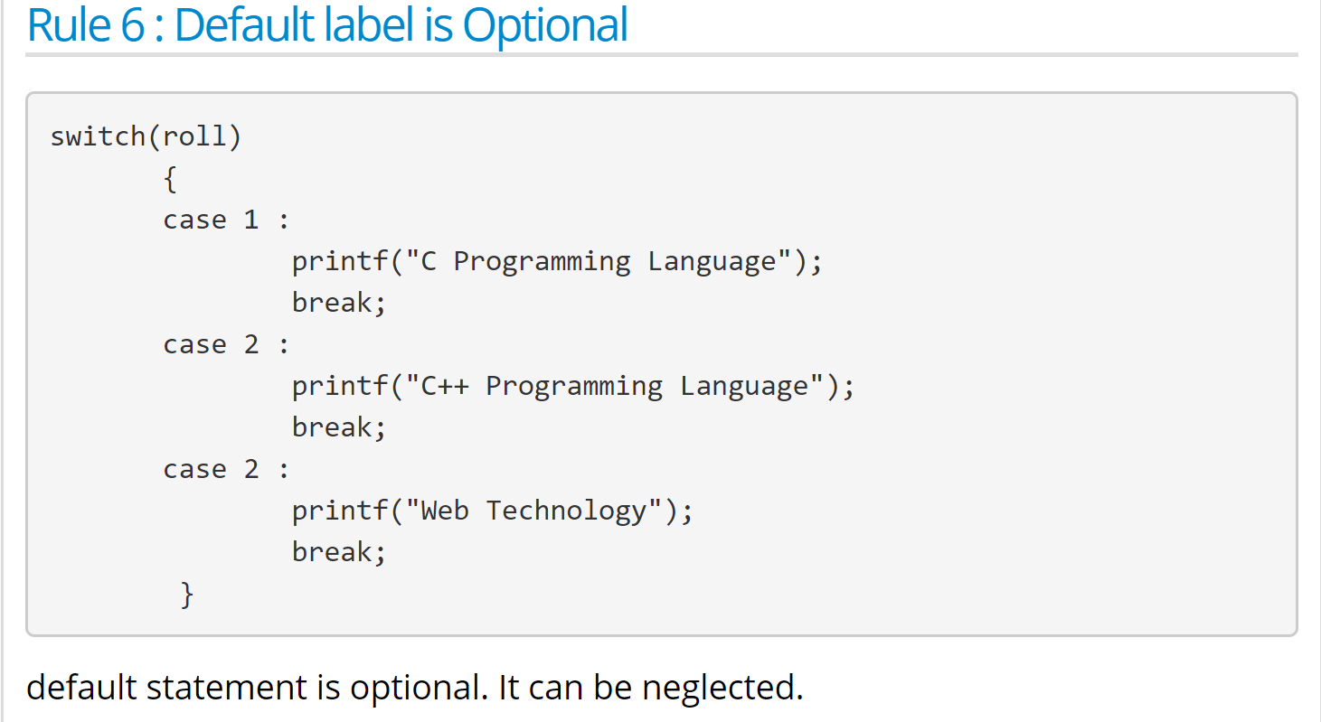

Slide 10
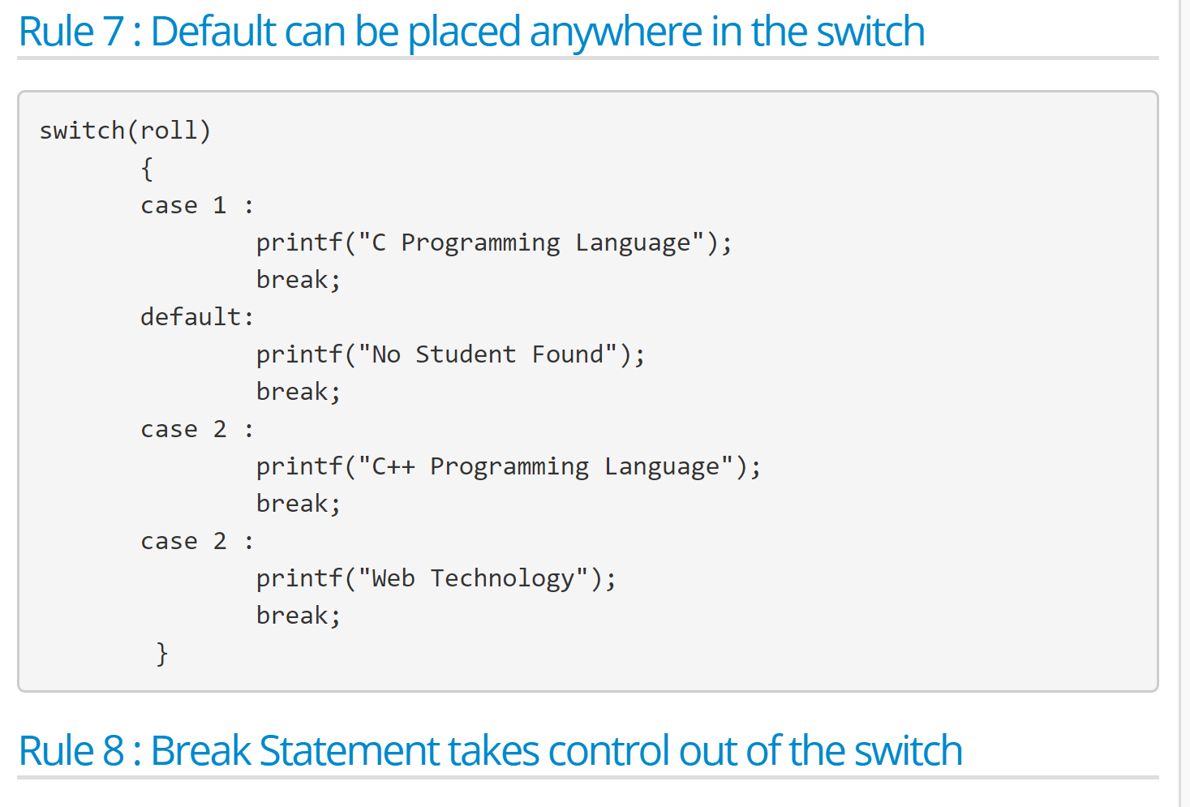

Slide 11
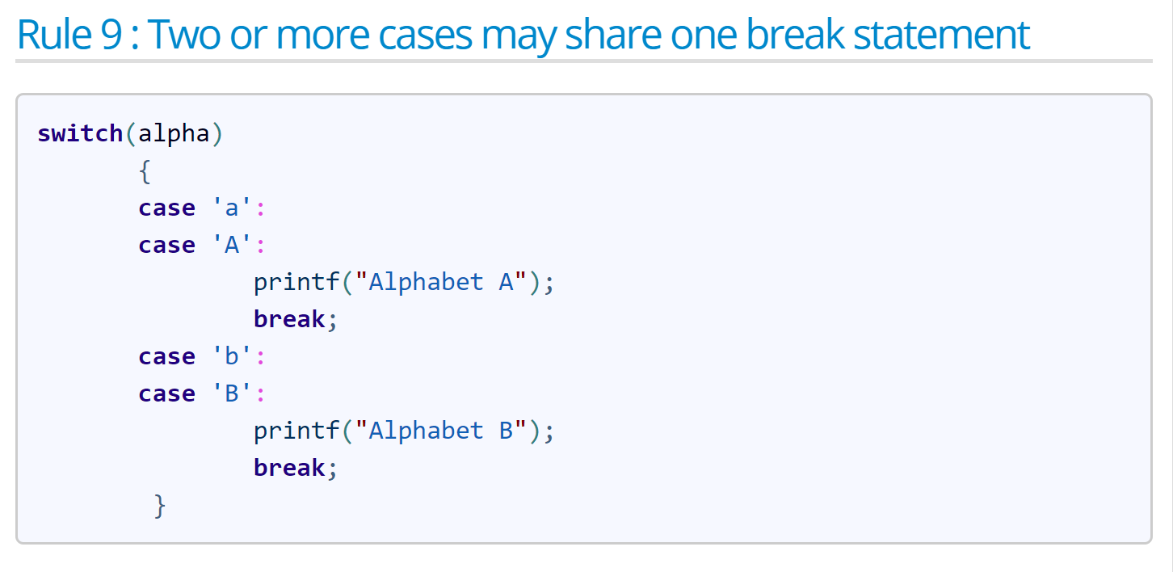

Slide 12
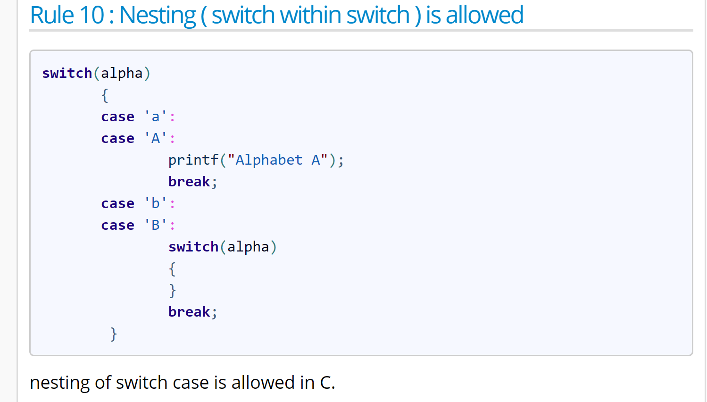

Slide 13
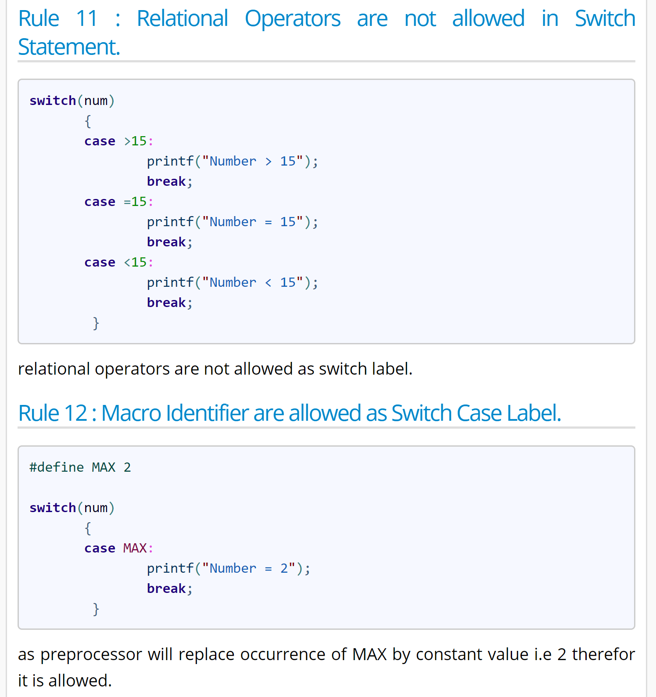

Slide 14
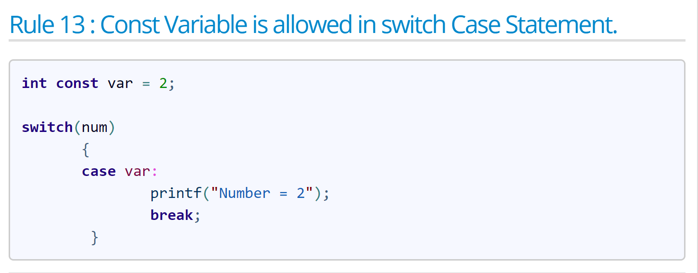

Slide 15
Invalid Ways of Switch Case
Floating point values are not allowed as Case Label.
Case Labels Should be Unique.
Variables are not allowed in switch case.
Comparison operators are not at all accepted.
All statements inside switch must be wrapped inside any of the case.

Slide 16
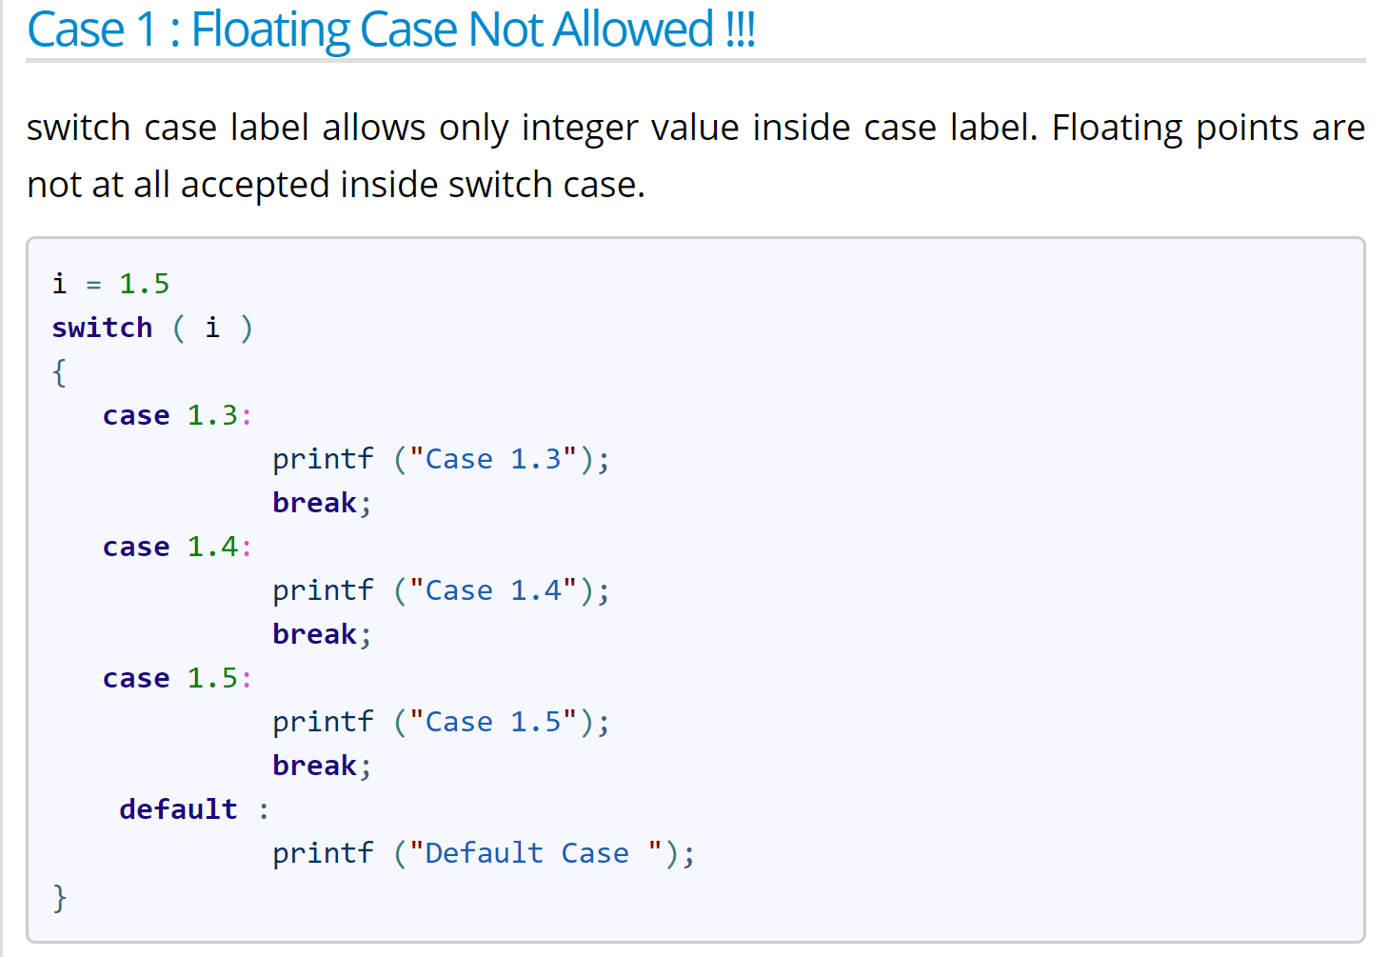

Slide 17
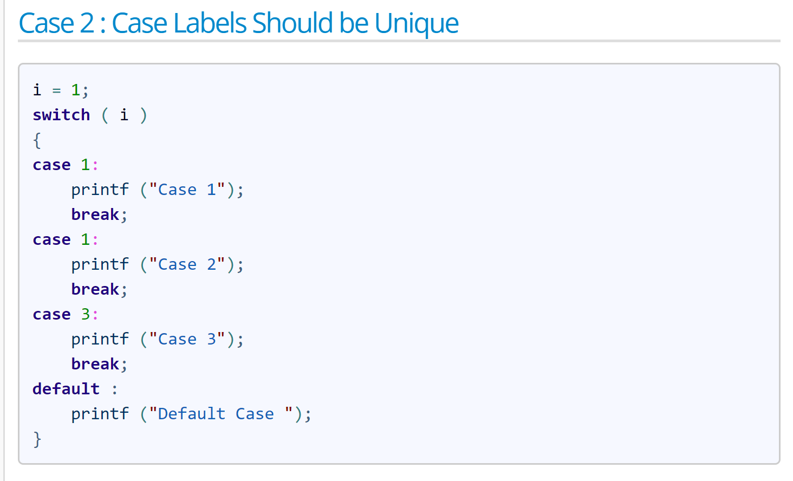

Slide 18
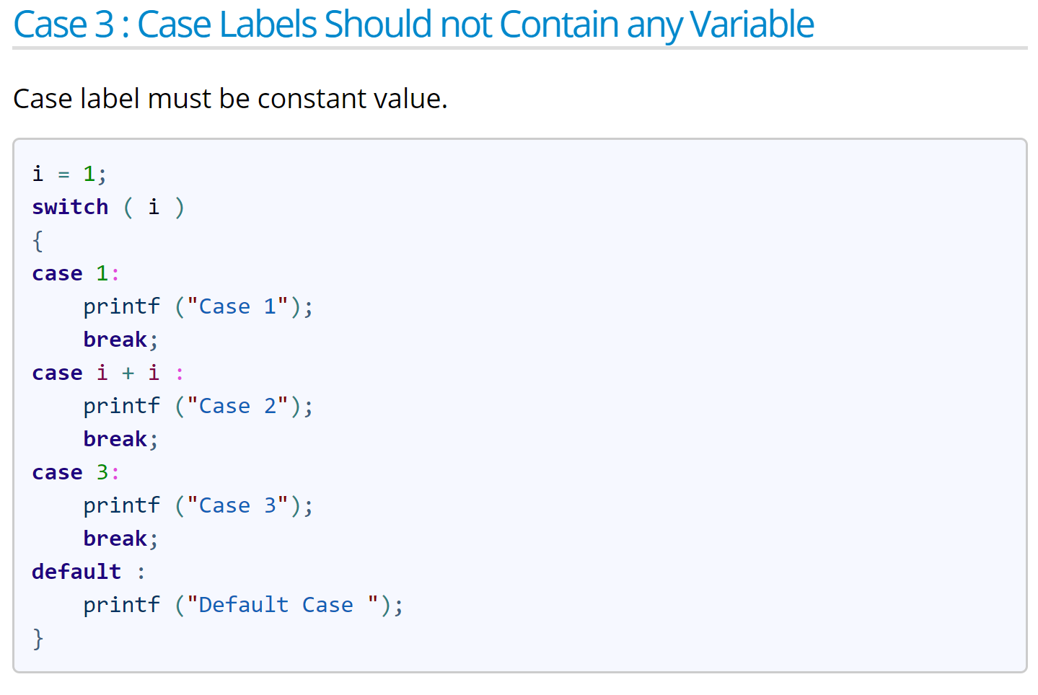

Slide 19
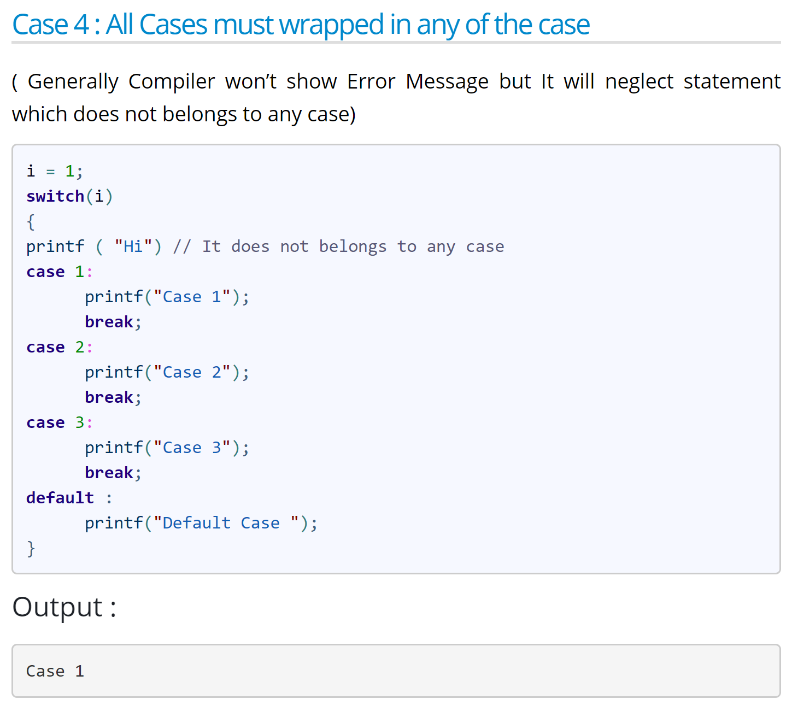

Slide 20
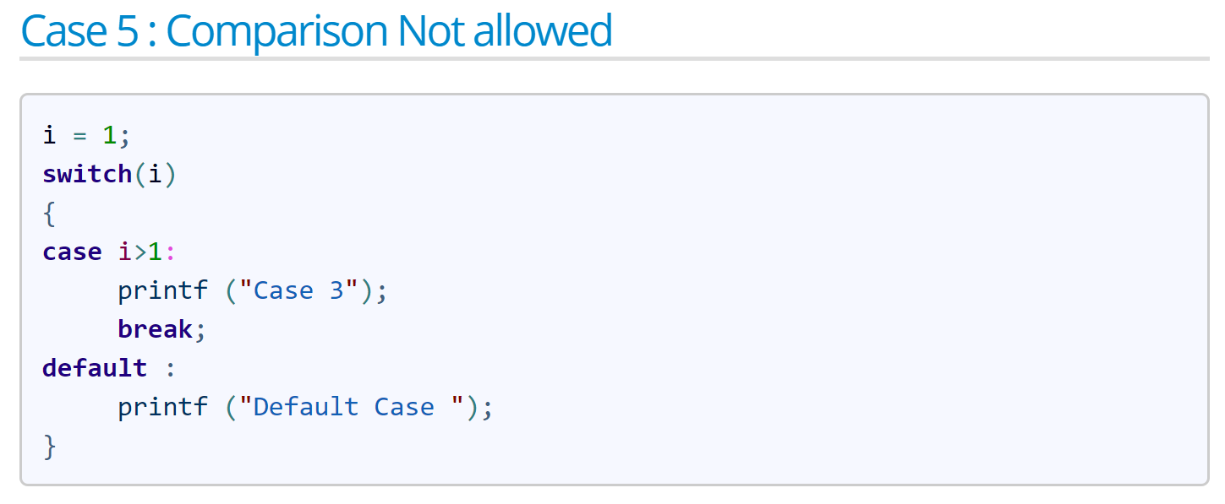

Slide 21
Q1
#include <stdio.h>
int main()
{
int num = 2;
switch (num + 2)
{
case 1:
printf("Case 1: ");
case 2:
printf("Case 2: ");
case 3:
printf("Case 3: ");
default:
printf("Default: ");
}
return 0;
}
#include <stdio.h>
int main()
{
int num = 2;
switch (num + 2)
{
case 1:
printf("Case 1: ");
case 2:
printf("Case 2: ");
case 3:
printf("Case 3: ");
default:
printf("Default: ");
}
return 0;
}

Slide 22
Q1 ANS
Output:
Default
Explanation: In switch, an expression “num+2” where num value is 2 and after addition the expression result is 4. Since there is no case defined with value 4 the default case got executed.

Slide 23
Q2
#include<stdio.h>
#define L 10
void main()
{
a = 10;
switch (a, a*2)
{
case L:
printf("ABC");
break;
case L*2:
printf("XYZ");
break;
case L*3:
printf("PQR");
break;
default:
printf("MNO");
case L*4:
printf("www");
break;
}
}

Slide 24
Q2 Ans
Output:
XYZ
Explanation: In C, comma is also operator with least precedence. So if
x = (a, b);
Then x = b
Note: Case expression can be macro constant.

Slide 25
Q3
#include<stdio.h>
void main()
{ switch(2)
{
case 1: printf("No");
case 2: printf("woww\n");
goto Love;
case 3: printf("Please");
case 4:Love: printf("FOR");
}
}

Slide 26
Q3 Ans
Output:
wowwFOR
Explanation: It is possible to write label of goto statement in the case of switch case statement.

Slide 27
Nested-Switch Statement:
Nested-Switch statements refers to Switch statements inside of another Switch Statements.

Slide 28
// syntax of Nested Switch Statements.
#include <stdio.h>
int main()
{
int x = 1, y = 2;
// Outer Switch
switch (x) {
// If x == 1
case 1: // Nested Switch
switch (y) {
// If y == 2
case 2: printf( "Choice is 2");
break;
// If y == 3
case 3: printf( "Choice is 3");
break;
}
break;
// If x == 4
case 4: printf( "Choice is 4");
break;
// If x == 5
case 5: printf( "Choice is 5");
break;
default: printf( "Choice is other than 1, 2 3, 4, or 5");
break;
}
return 0;
}
Output:Choice is 2

Slide 29
Q4
// float is not allowed in switch
#include <stdio.h>
int main()
{
float x = 1.1;
switch (x)
{
case 1.1: printf("Choice is 1");
break;
default: printf("Choice other than 1, 2 and 3");
break;
}
return 0;
}

Slide 30
Q4 Ans
Output:
Compiler Error: switch quantity not an integer

Slide 31
Q5
#include <stdio.h>
int main()
{
int x = 2;
switch (x)
{
case 1: printf("Choice is 1\n");
case 2: printf("Choice is 2\n");
case 3: printf("Choice is 3\n");
default: printf("Choice other than 1, 2 and 3\n");
}
return 0;
}

Slide 32
Q5
Output:
Choice is 2
Choice is 3
Choice other than 1, 2 and 3
All the statements following a matching case execute until a break statement is reached.

Slide 33
Q6
#include <stdio.h>
int main()
{
int x = 2;
switch (x)
{
case 1: printf("Choice is 1\n");
case 2: printf("Choice is 2\n");
case 3: printf("Choice is 3\n");
case 4: printf("Choice is 4\n");
break;
default: printf("Choice other than 1, 2, 3 and 4\n");
break;
}
printf("After Switch");
return 0;
}

Slide 34
Q6 Ans
Output:
Choice is 2
Choice is 3
Choice is 4
After Switch

Slide 35
Q7
#include <stdio.h>
int main()
{
int x = 4;
switch (x)
{
default: printf("Choice other than 1 and 2");
break;
case 1: printf("Choice is 1");
break;
case 2: printf("Choice is 2");
break;
}
return 0;
}

Slide 36
Q7
// The default block is placed above other cases.
Output:
Choice other than 1 and 2

Slide 37
Q8
// A program with variable expressions in labels
#include <stdio.h>
int main()
{
int x = 2;
int arr[] = {1, 2, 3};
switch (x)
{
case arr[0]: printf("Choice 1\n");
case arr[1]: printf("Choice 2\n");
case arr[2]: printf("Choice 3\n");
}
return 0;
}

Slide 38
Q8 Ans
Output:
Compiler Error: case label does not reduce to an integer constant

Slide 39
Q9
#include <stdio.h>
int main()
{
int x = 1;
switch (x)
{
x = x + 1;
case 1: printf("Choice is 1");
break;
case 2: printf("Choice is 2");
break;
default: printf("Choice other than 1 and 2");
break;
}
return 0;
}

Slide 40
Q9 ANS
Output:
Choice is 1
The statements written above cases are never executed
After the switch statement, the control transfers to the matching case, the statements written before case are not executed.

Slide 41
Switch – controlling expressions
// Constant expressions allowed
switch(1+2+23)
switch(1*2+3%4)
// Variable expression are allowed provided // they are assigned with fixed values switch(a*b+c*d)
switch(a+b+c)

Slide 42
Range in a Switch
You can use range of numbers instead of a single number or charater in case statement
You can specify a range of consecutive values in a single case label, like this:case low ... high:
It can be used for ranges of ASCII character codes like this: case 'A' ... 'Z':
You need to Write spaces around the ellipses … . For example, write this:// Correct - case 1 ... 5: // Wrong - case 1...5:

Slide 43
// Q10 using range in switch case
// C program to illustrate
#include <stdio.h>
int main()
{
int arr[] = { 1, 5, 15, 20 };
for (int i = 0; i < 4; i++)
{
switch (arr[i])
{
case 1 ... 6:
printf("%d in range 1 to 6\n", arr[i]);
break;
case 19 ... 20:
printf("%d in range 19 to 20\n", arr[i]);
break;
default:
printf("%d not in range\n", arr[i]);
break;
}
}
return 0;
}

Slide 44
Q10 ANS
Output:
1 in range 1 to 6
5 in range 1 to 6
15 not in range
20 in range 19 to 20

Slide 45
Q11
#include<stdio.h>
int const L=10;
void main() {
int a = 10;
switch (a, a*2) {
case L : printf("ABC"); break;
case L*2 : printf("XYZ"); break;
case L*3 : printf("PQR"); break;
default: printf("MNO");
case L*4 : printf("www"); break;
}
}

Slide 46
Q11 Ans
main.c:15:2: error: case label does not reduce to an integer constant case L:

Slide 47
Q12
#include <stdio.h>
int main() {
int x ;
scanf("%d",&x);
switch (x) {
case 1: printf("Choice 1\n"); break;
case 2: printf("Choice 2\n"); break;
case 3: printf("Choice 3\n"); break;
default: printf("What"); }
return 0; }

Slide 48
Q12 Ans
During Run time acc to the value x takes the case changes
In the case of #define (Preprocessor Directive) the compiler assigns the value at compile time

Slide 49
THANKYOU!!!

